Slide 1
Advance SQL Project Presentation

Slide 2
agenda
Categorize customers into three categories based on their credit Limit:
Use a CTE to calculate the total sales made by each employee.
Identify customers whose total payments exceed $10,000. Return customer Name, credit Limit, and total payment amount.
Create a view that tracks total sales per product (using quantity Ordered * price Each) for each month. The view should also rank products by sales volume each month.
Identify employees who have processed sales exceeding $100,000 in total sales. For each employee, show their total sales, rank them based on sales, and calculate their average order size (using quantity Ordered and price Each).

Slide 3
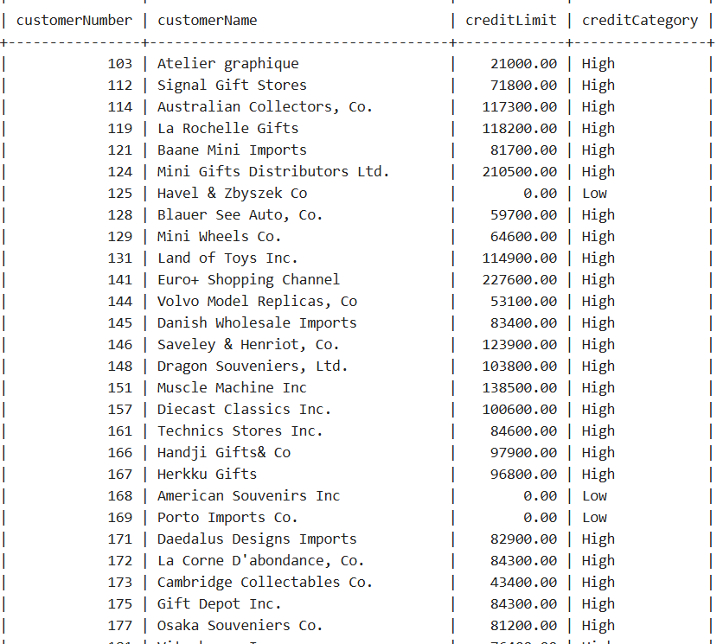
Syntax: CASE WHEN condition1 THEN result1 WHEN condition2 THEN result2 WHEN conditionN THEN resultN ELSE result END;
SQL QUERY:
select customerNumber,customerName,creditLimit,
case
when creditLimit < 5000 Then 'Low'
when creditLimit Between 5000 and 20000 Then 'Medium'
Else 'High'
End as creditCategory
from customers;

Slide 4
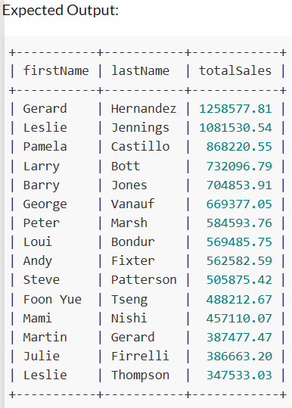
Syntax:
WITH cte_name (column1, column2, ...) AS
( subquery ) SELECT columns FROM cte_name WHERE condition;
SQL QUERY:
WIth salesbyeachemployee As (
select e.firstName,e.lastName,
sum(od.quantityOrdered * od.priceEach) as totalsales
from Employees e
inner join Customers c
on c.salesRepEmployeeNumber=e.employeeNumber
inner join Orders o
on c.customerNumber=o.customerNumber
inner join OrderDetails od
on o.orderNumber=od.orderNumber
group by
e.firstName,
e.lastname
)
SELECT*FROM salesbyeachemployee ORDER BY totalSales DESC;

Slide 5
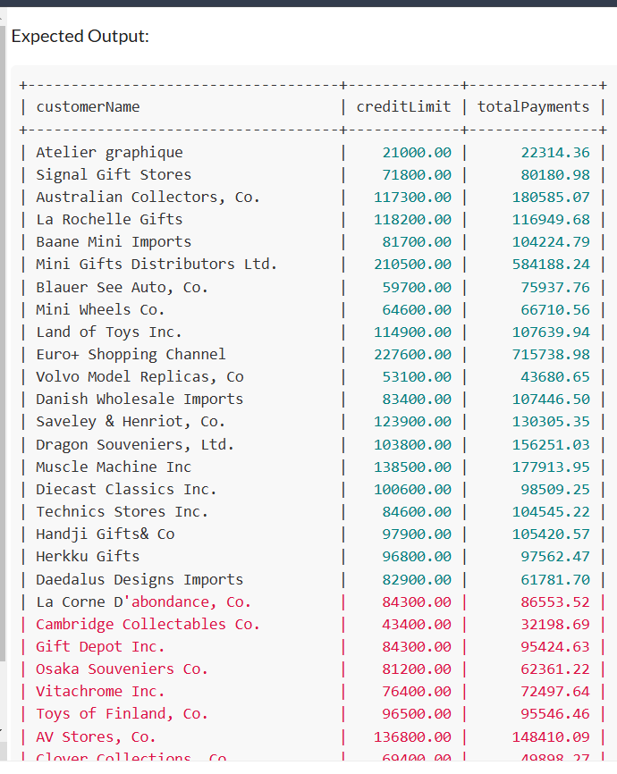
Query: Identify customers whose total payments exceed $10,000. Return customerName, creditLimit, and total payment amount.
SQL QUERY:
select c.customerName,c.creditLimit,sum(p.amount) as totalPayments
from customers c
right join payments p
on c.customerNumber=p.customerNumber
group by c.customerName,c.creditLimit
having totalPayments >10000;

Slide 6
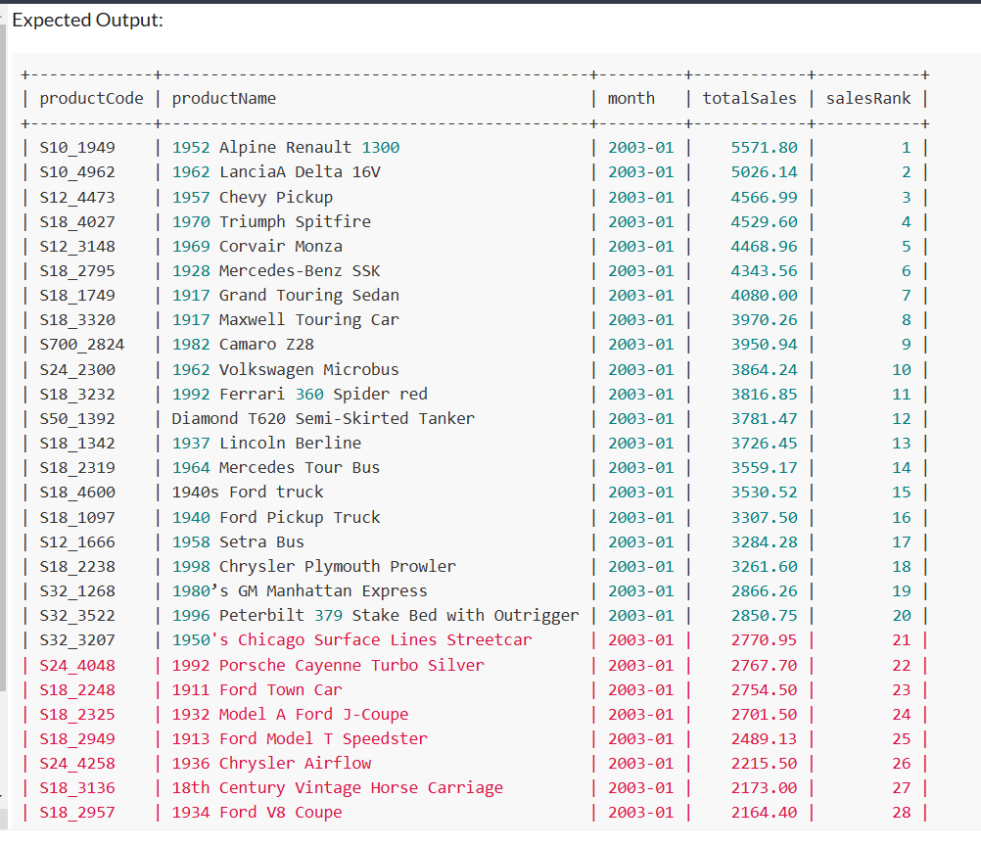
Syntax: CREATE VIEW view_name AS SELECT column1, column2, ... FROM table_name WHERE condition;
SQL QUERY: create View ProductSalesByMonth ASselect p.productCode,p.productName,
DATE_FORMAT(o.orderDate, '%Y-%m') AS month,
SUM(od.quantityOrdered * od.priceEach) AS totalSales,
RANK() OVER (PARTITION BY DATE_FORMAT(o.orderDate, '%Y-%m')
ORDER BY SUM(od.quantityOrdered * od.priceEach) DESC) AS salesRank
FROM products p INNER JOIN orderDetails od ON p.productCode = od.productCode
INNER JOIN orders o ON od.orderNumber = o.orderNumber
GROUP BY p.productCode,p.productName,
DATE_FORMAT(o.orderDate, '%Y-%m');
select * from ProductSalesByMonth;

Slide 7
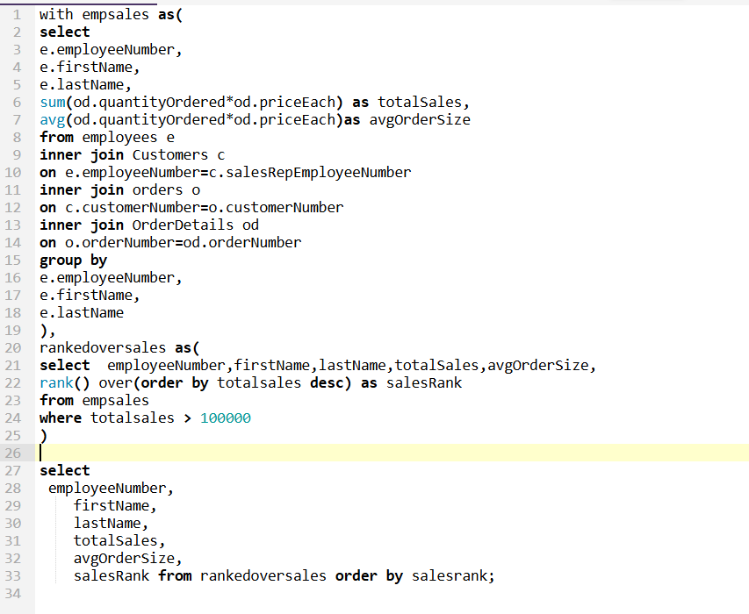
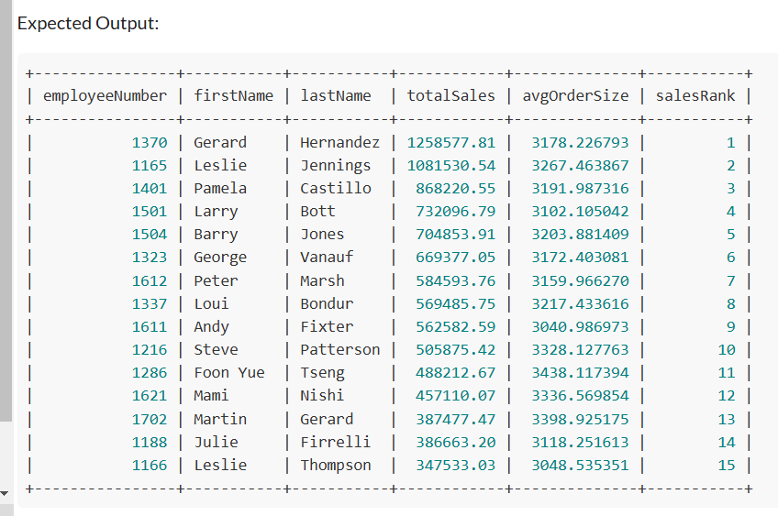
Syntax: WITH SET1 AS (SELECT SYSDATE FROM DUAL), -- SET1 initialised SET2 AS (SELECT * FROM SET1) -- SET1 accessed SELECT * FROM SET2; -- SET2 projected ;

Slide 8
Thank you

